Slide 1

CS/CDMA/STAT 3654 Projects Spring 2024
Instructor: Sehrish Basir Nizamani

Slide 2

Have a balanced team
Teamwork
Zoom meet/In-person meet

Slide 3
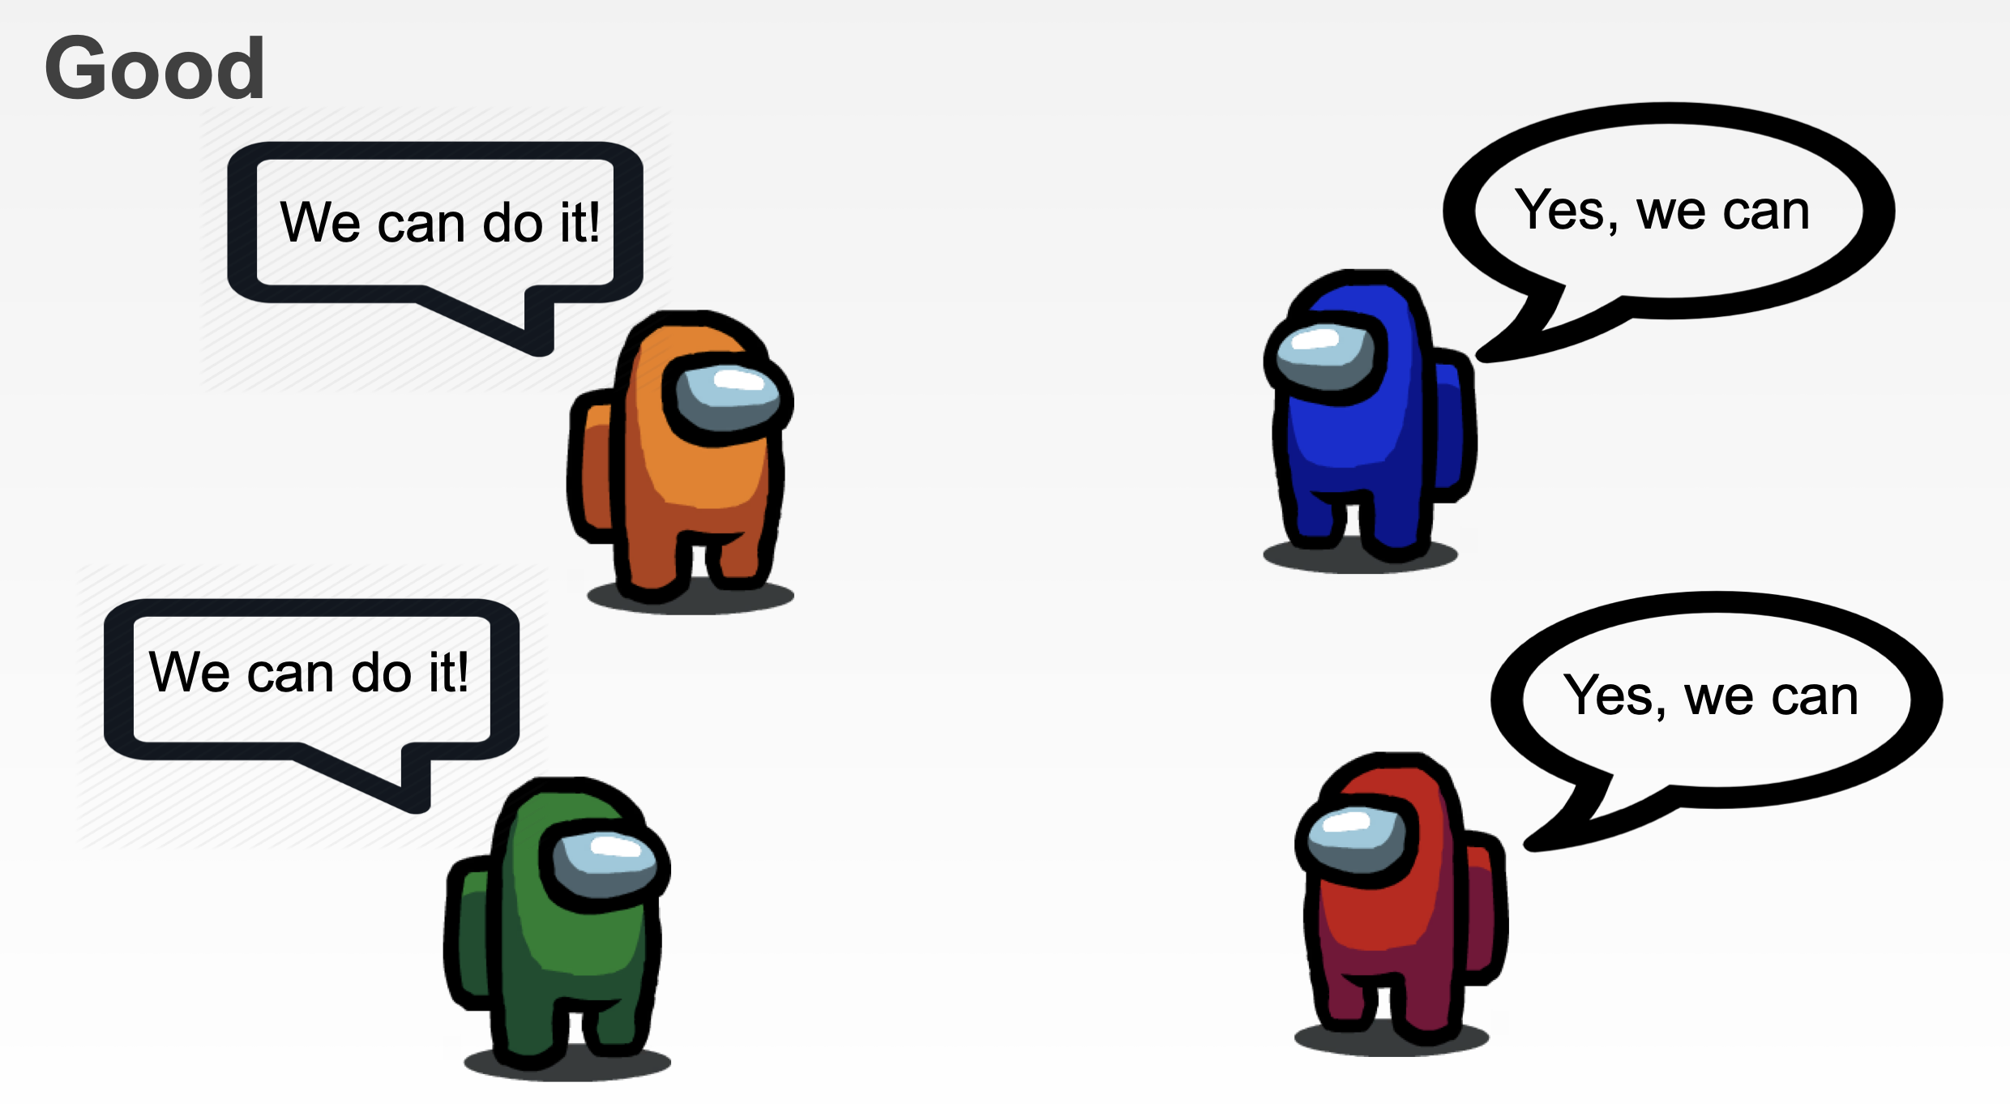

Slide 4
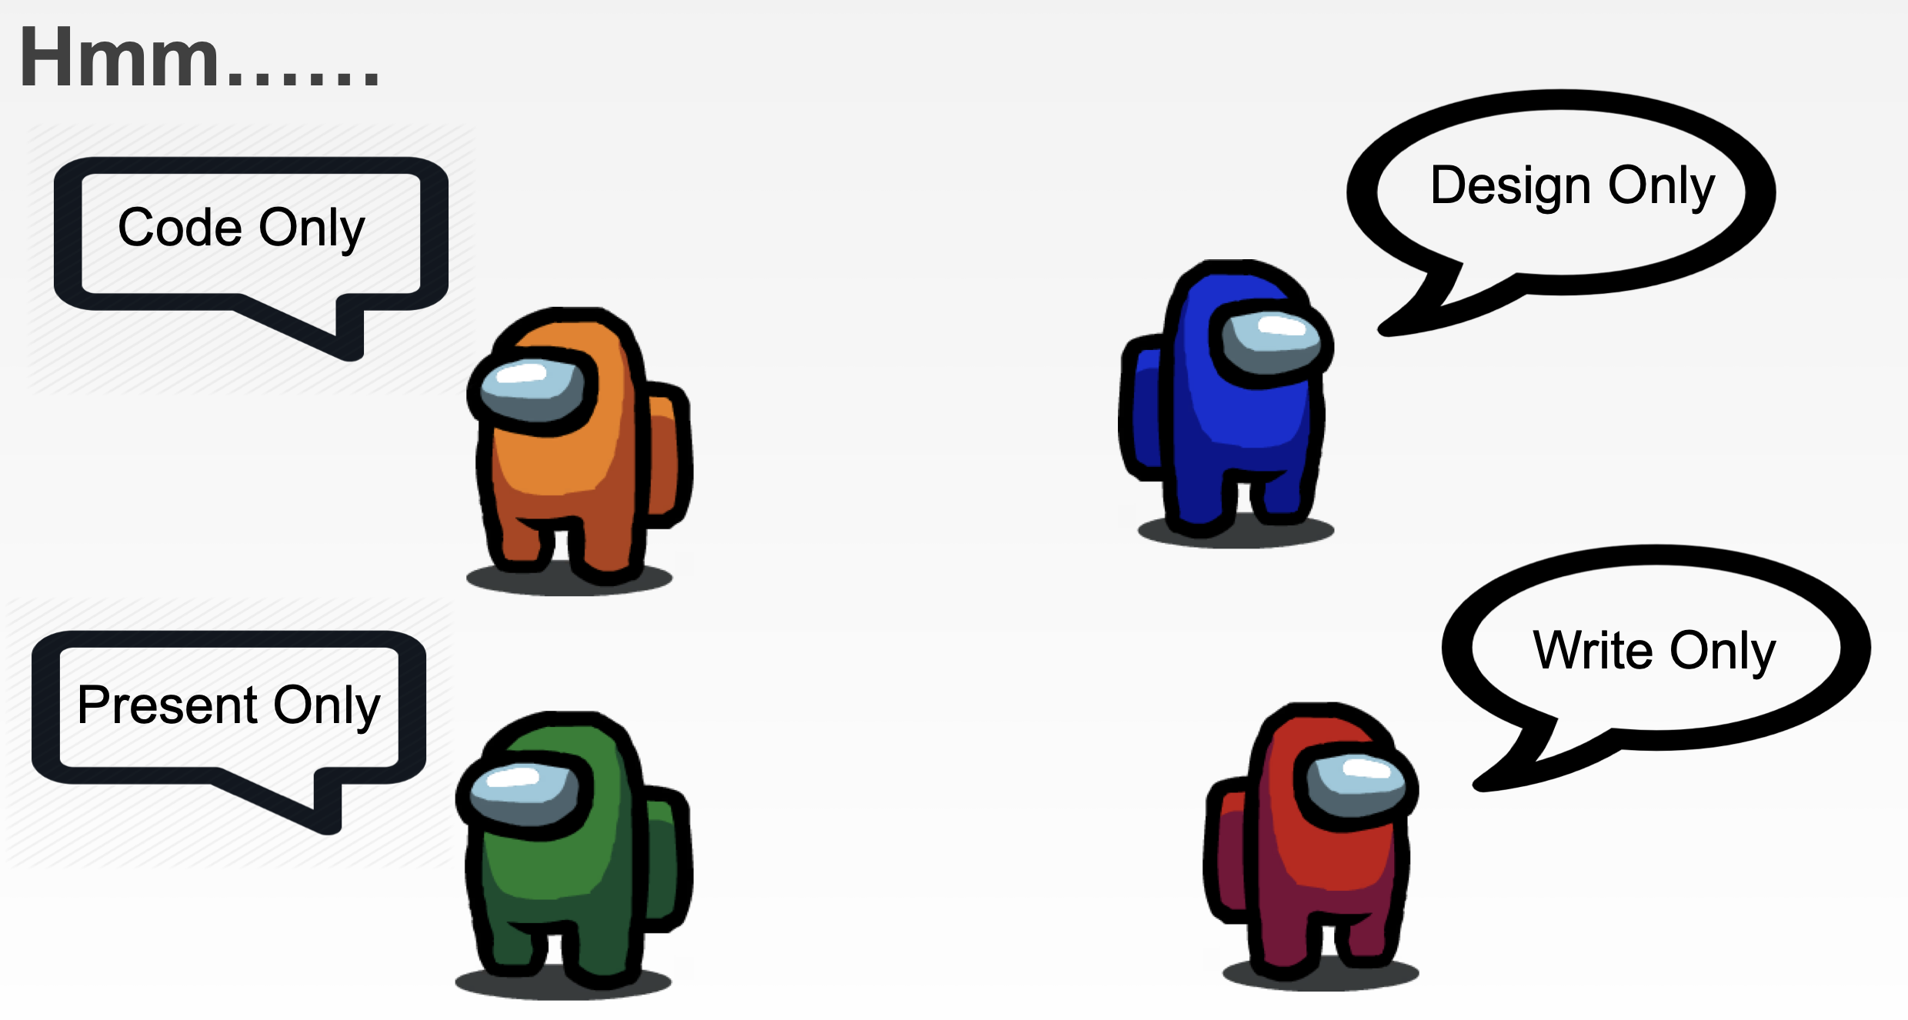

Slide 5
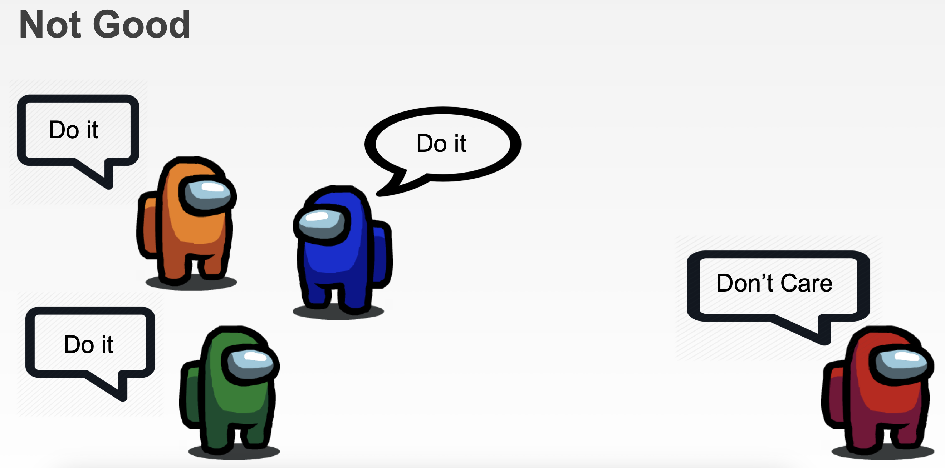

Slide 6
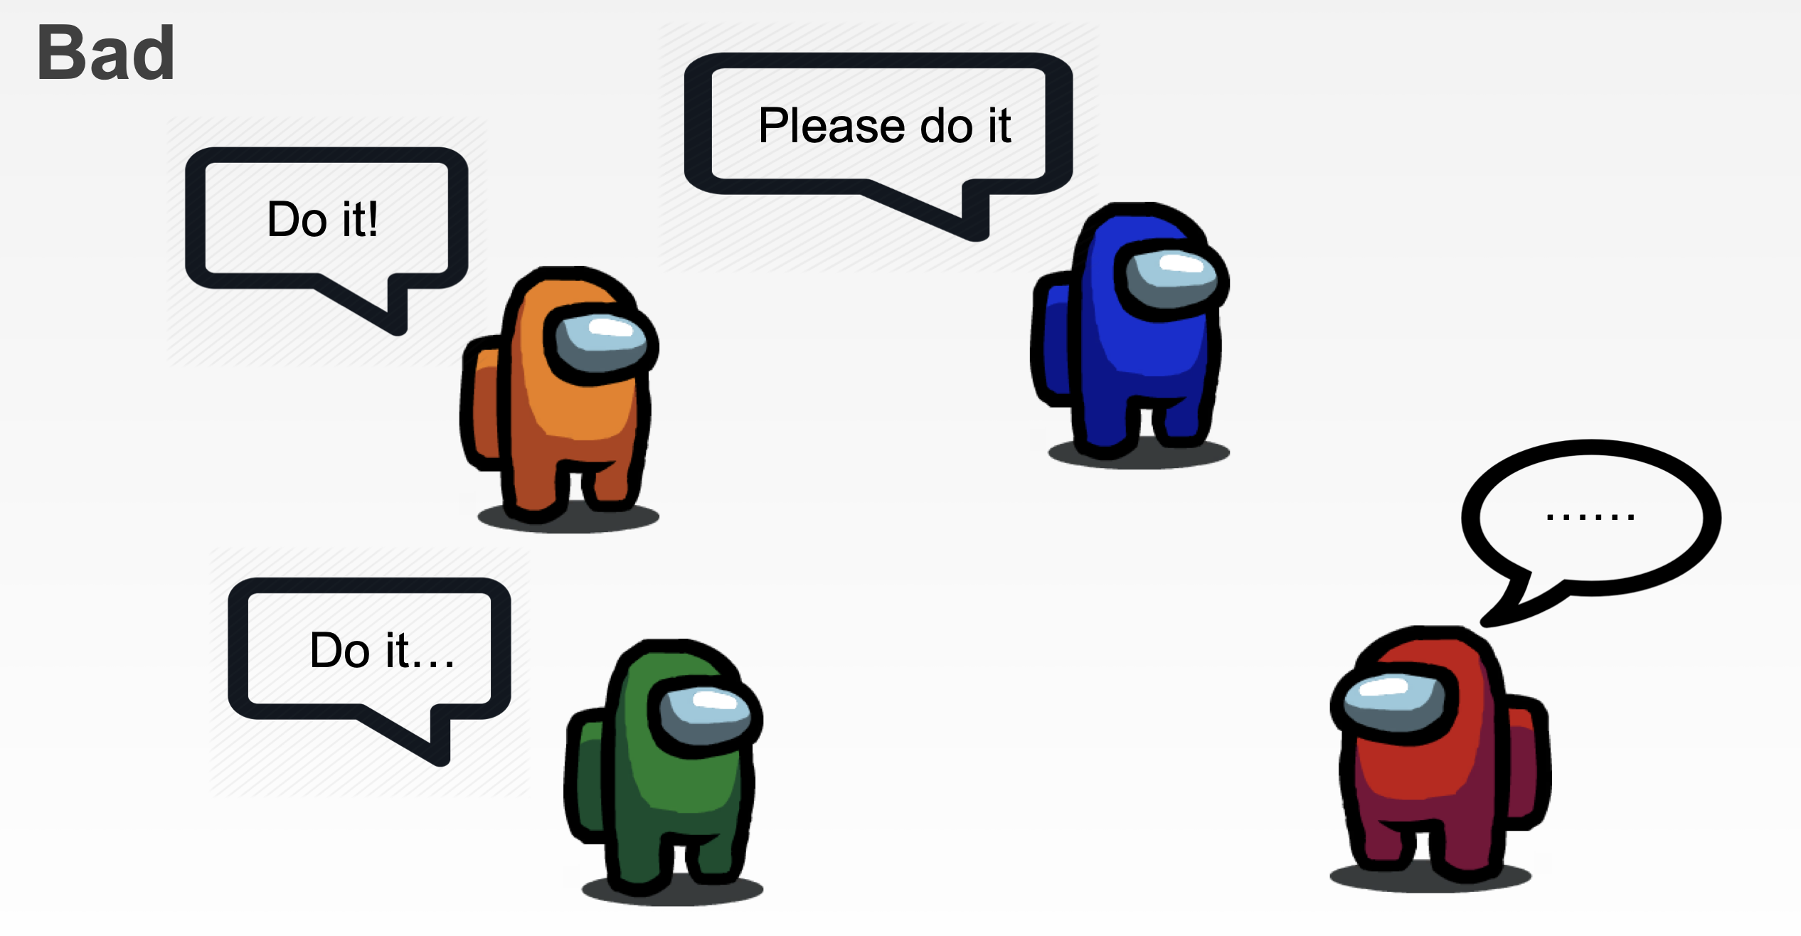

Slide 7
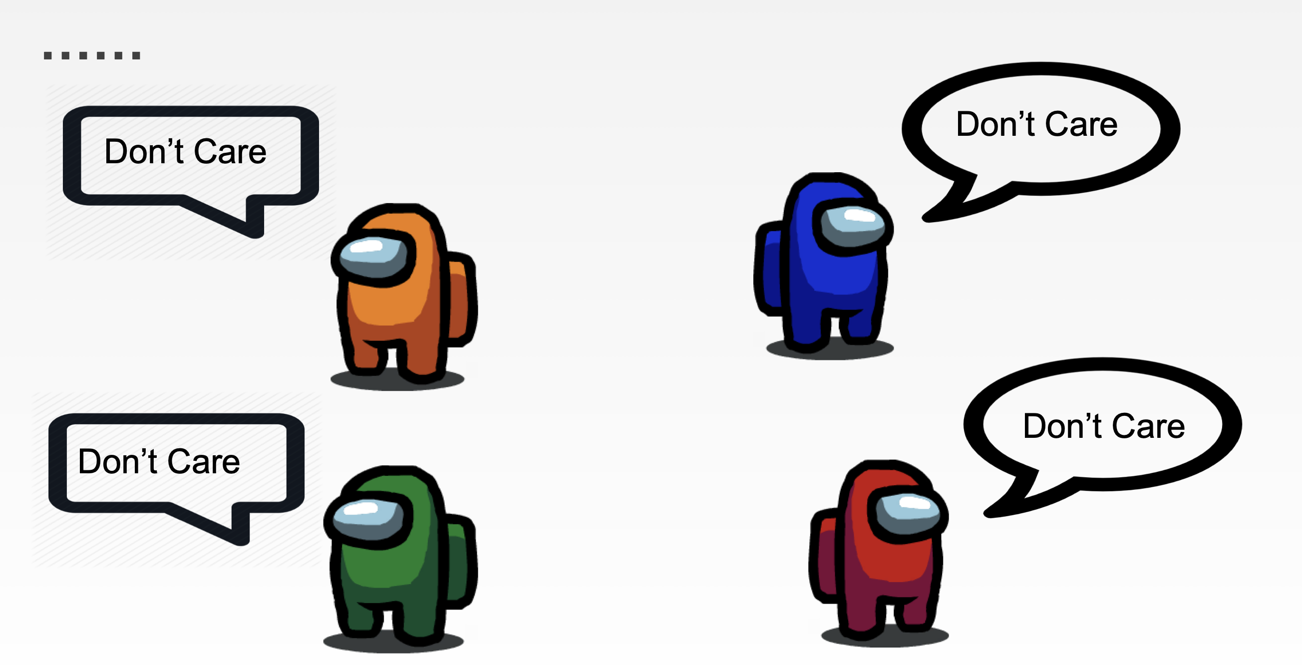

Slide 8
Which is most challenging
Covering a topic for
Quiz / Exam /Grades
Teaching to someone else
Applying in the real world

Slide 9

What is the difference between studying and learning?

Slide 10
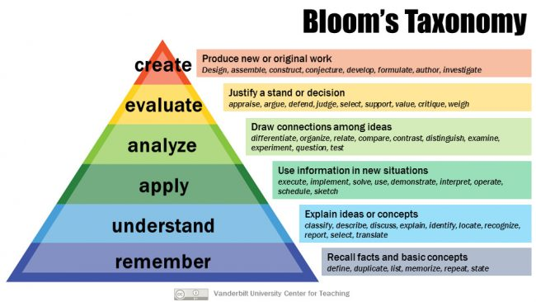

Slide 11



Datasets
with 25 million datasets available
https://corgis-edu.github.io/corgis/
https://github.com/awesomedata/awesome-public-datasets
popular data-science competition website that provides free public datasets you can use to learn artificial intelligence (AI) and machine learning (ML).
Kaggle has a collection of over 68,000 datasets
https://www.kaggle.com/datasets

Slide 12



Datasets
https://data.gov
https://projects.fivethirtyeight.com
Home - UCI Machine Learning Repository
https://archive.ics.uci.edu
List of datasets for machine-learning research – Wikipedia
https://en.wikipedia.org/wiki/List_of_datasets_for_machine-learning_research

Slide 13
Web Scraping
Web scraping refers to the process of extracting data from websites.
Using Python Libraries:
BeautifulSoup: A popular Python library for parsing HTML and XML documents. It provides easy-to-use methods for navigating and extracting data from web pages.
Scrapy: A powerful web crawling and scraping framework for Python. It allows you to define the structure of the website you want to scrape and extract data in a structured format.

Slide 14
Leveraging Existing Data for Insights
Usually difficult to acquire.
If you have access, you can use it for unlocking hidden opportunities and driving informed decision-making.

Slide 15
Project Collaboration / Teams
Collaboration enhances creativity, problem-solving, and overall project outcomes.
In machine learning, diverse perspectives lead to more robust models and solutions.
Effective collaboration fosters a positive team environment, boosting morale and productivity.

Slide 16
Clear Communication
Communication is key to successful collaboration.
Establish regular meetings to discuss progress, challenges, and goals.
Utilize communication tools such as Slack, Microsoft Teams, or Discord for real-time discussions.

Slide 17
Define Roles and Responsibilities
Clearly define roles and responsibilities within the team.
Assign tasks based on individual strengths and expertise.
Regularly reassess and adjust roles as needed to ensure efficiency.

Slide 18
Establishing Goals and Milestones
Set clear, achievable goals and milestones for the project.
Break down the project into smaller tasks with specific deadlines.
Regularly track progress towards goals and celebrate milestones reached.

Slide 19
Foster a Collaborative Environment
Encourage open communication and constructive feedback.
Create a safe space for sharing ideas and asking questions.
Value each team member's contributions and perspectives.

Slide 20
Peer Review and Code Reviews
mplement peer review and code review processes.
Review each other's code for errors, efficiency, and adherence to best practices.
Provide constructive feedback to help improve the quality of code and models.

Slide 21
Handling Conflicts
Address conflicts or disagreements promptly and respectfully.
Encourage open dialogue to understand different perspectives.
Focus on finding solutions and compromises that benefit the project and team.

Slide 22
Conclusion
Effective collaboration is essential for success in data science and machine learning projects
By following these strategies and best practices, you can maximize collaboration within your project teams.

Slide 23

Let's build the teams

